Slide 1
Engineers in Society
Selected Topics in Sociology
Jessica Breakey
School of Electrical Engineering
University of the Witwatersrand

Slide 2
This is not an “engineering course’’ but a course designed to help engineers “ fill in the gaps’’

Slide 3
The individual and Society
The Social Science
‘’The Sociological Imagination’’:
‘’ the ability to think beyond our personal lives and to connect the experiences of individuals with large social structures’’

Slide 4
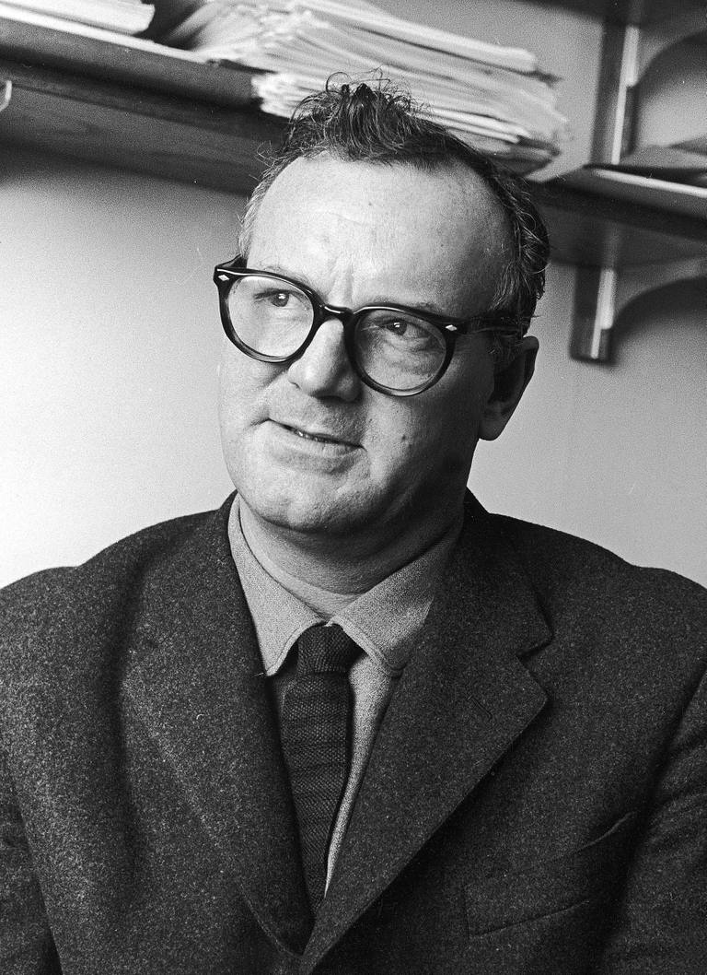
C.Wright Mills (1959)
The ‘’Sociological Imagination’’
’neither the life of an individual nor the history of a society can be understood without understanding both’’

Slide 5
Social Change for a better world
Knowledge is required for social change
You can only gain knowledge through critical thinking
Through critical thinking you obtain a sociological imagination
Through developing a sociological imagination we understand our own lives better because we understand society and our context better

Slide 6
Personal Troubles vs Social Issues
Troubles: occur within the character of the individual- it is a ‘private matter’
Issues: transcend the local environment and inner life of the individual. Has to do with organizations, structures and society- it is a ‘public matter’
Eg. –Employment, marriage, university fees

Slide 7

“Moving forward hasn’t been so easy for blacks. The structural effects of apartheid are still evident in the layout of our cities, in our schools, and universities and in our workplaces. Even those born after 1994 deal with interpersonal and institutional racism on a daily basis.”
[Sisonke Msimang – The End of the Rainbow Nation Myth]

Slide 8
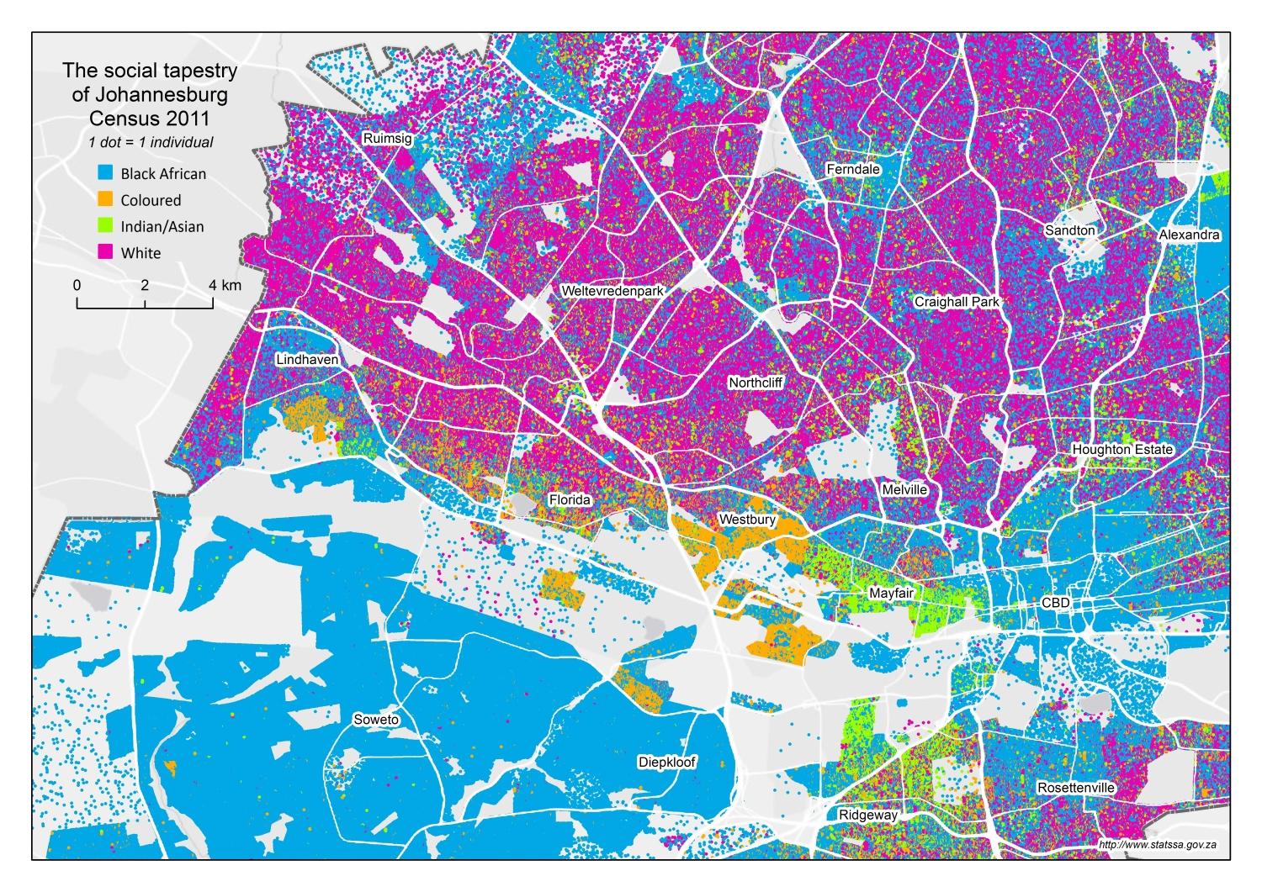

Slide 9
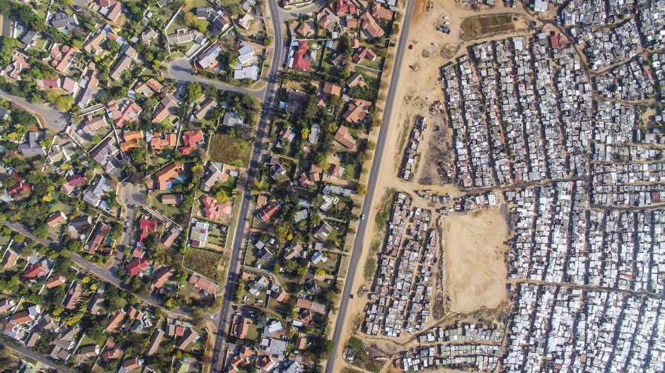

Slide 10
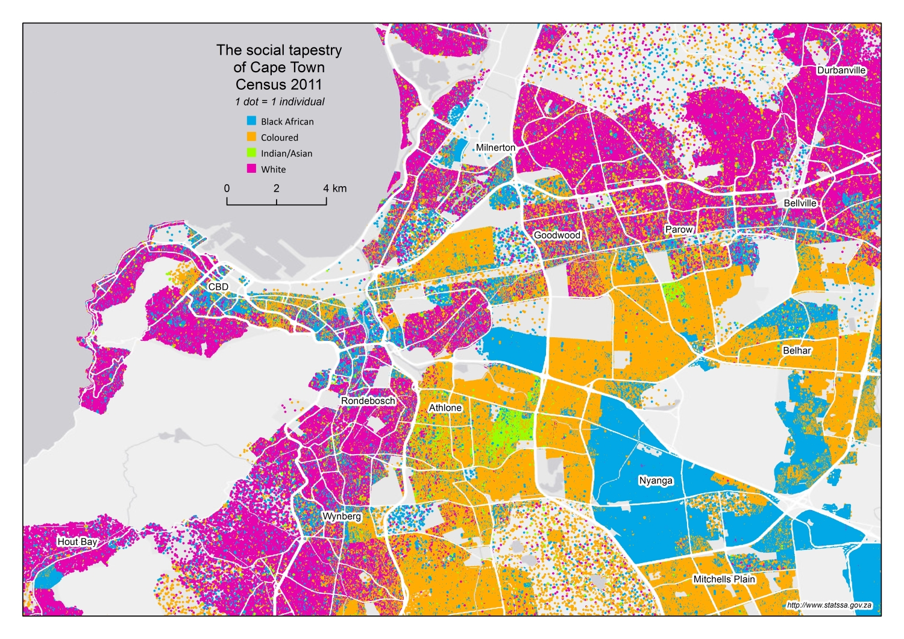

Slide 11
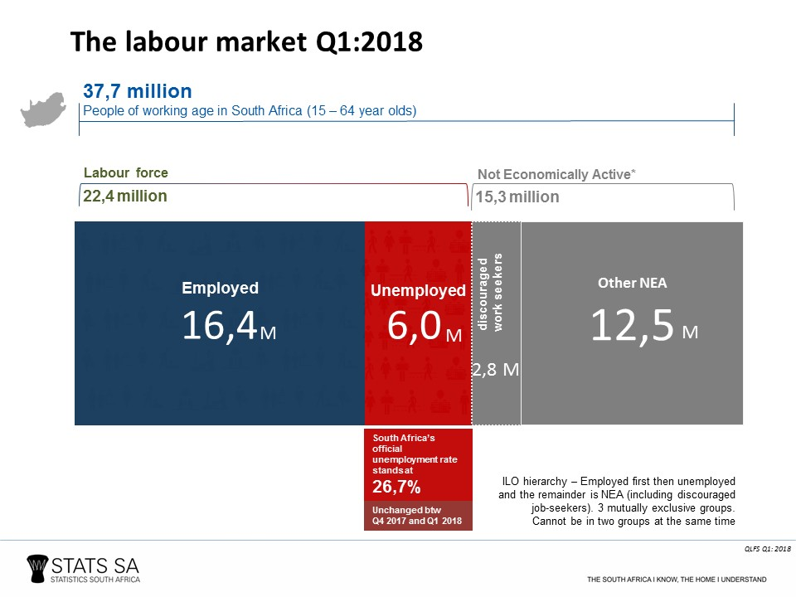

Slide 12
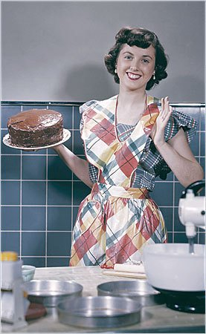
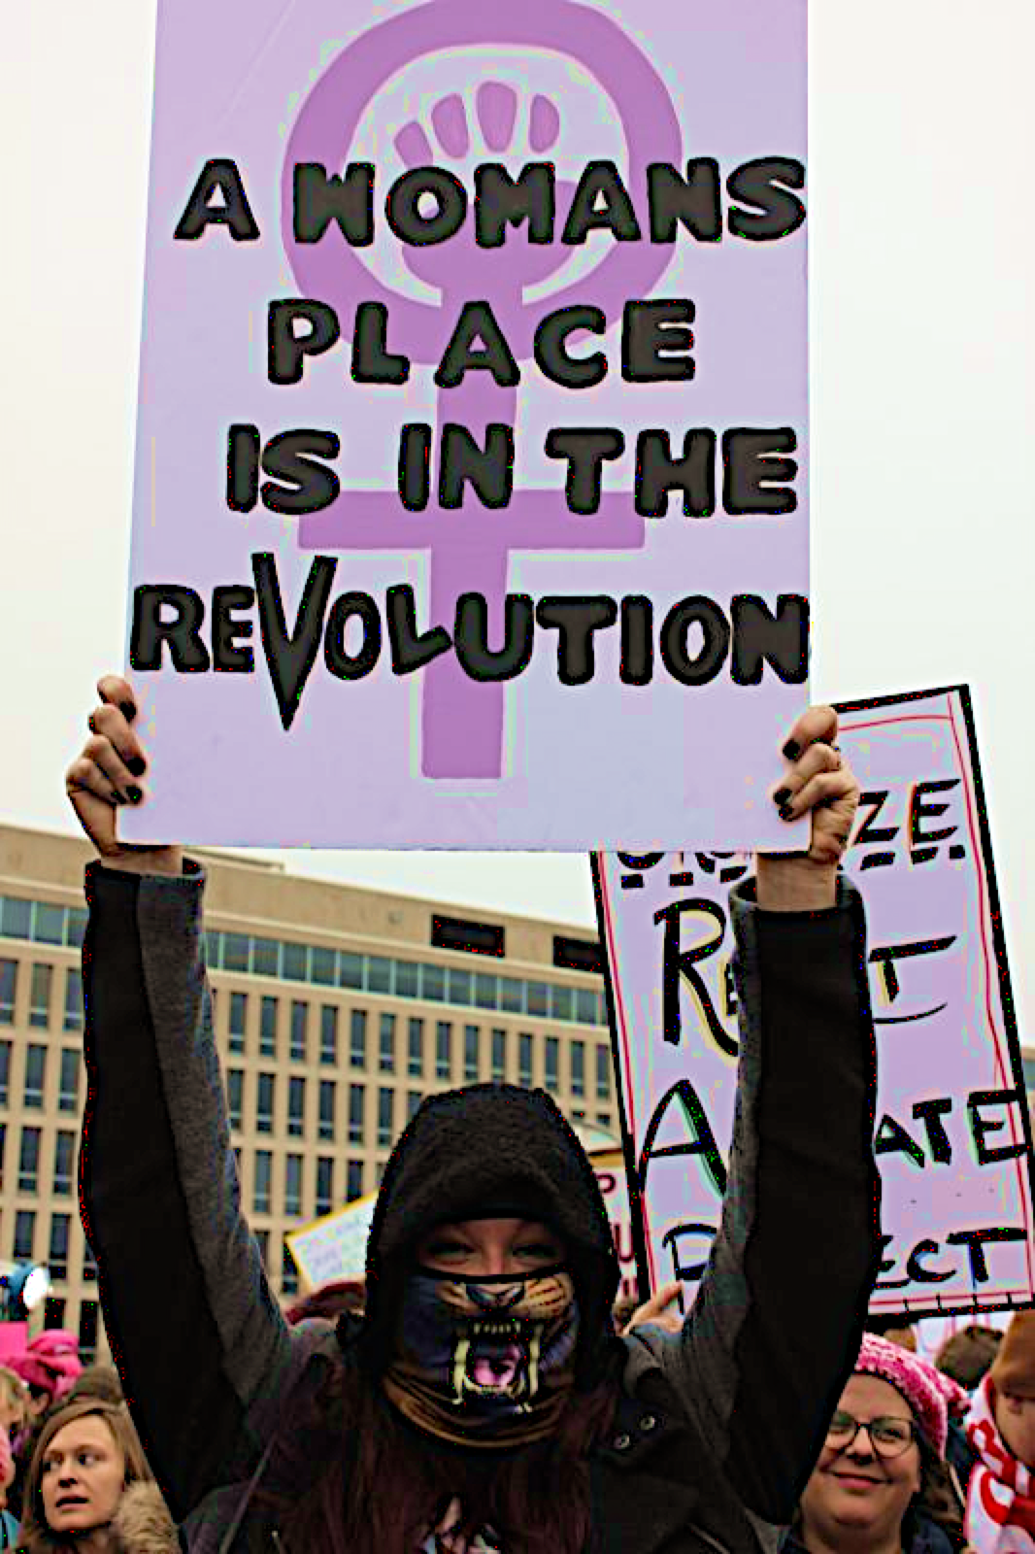
Our lived experiences are not static – on the contrary, they are constantly changing.

